Slide 1
AI-Powered Resume
A Dataset Analysis
By Joshua Villarojo
INFO 4670

Slide 2
Introduction
This project analyzes an AI-powered resume screening dataset from Kaggle. The dataset contains details on job applicants, including their skills, education, experience, and recruiter decisions.
Key Research Questions:
What factors influence AI Score?
Which skills are most common among hired candidates?
How do salary expectations differ across job roles?
Does higher education lead to better AI Scores?

Slide 3
Pivot Charts
Pivot Tables and Pivot Charts were used to:
Find Salary Expectations across different job roles
Correlation between Project Count and AI Scores.
Average AI Scores and Hire count based on level of Education.
Analyze the relationship between experience, projects, and AI scores.

Slide 4

VLOOKUP
VLOOKUP was used to retrieve a candidate’s name based off the user-given resume ID.
T
This function’s purpose is used to efficiently identify the name of a candidate
Example Output:

Slide 5
HLOOKUP
This function was used to quickly find the average salary based on the selected job role.
A Separate table generated horizontally was required since the raw data was generated vertically.

Slide 6
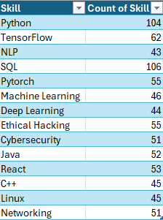
Most Common Skills
It was found that the most common skills among hired candidates were Python and SQL.
Creating this insight required a separate table as in the raw dataset, the skills in each candidate were grouped due to candidates having multiple skills in their resume.

Slide 7
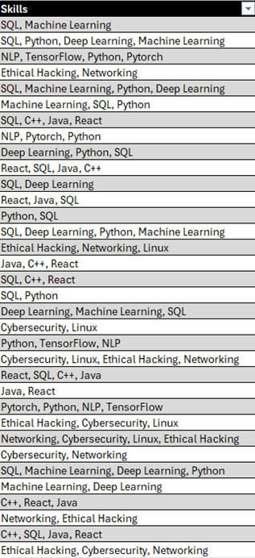
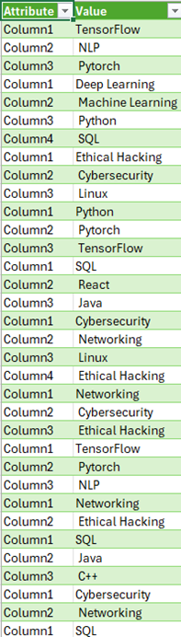
Most Common Skills Cont.
The left image is the skills column from the raw dataset.
The Right Image is the transposed Dataset using Power Query to separate the skills for a more accurate and efficient skill count amongst all candidates.
Then, using the newly generated table, the COUNTIF function is used to add to the count of the skills.

Slide 8
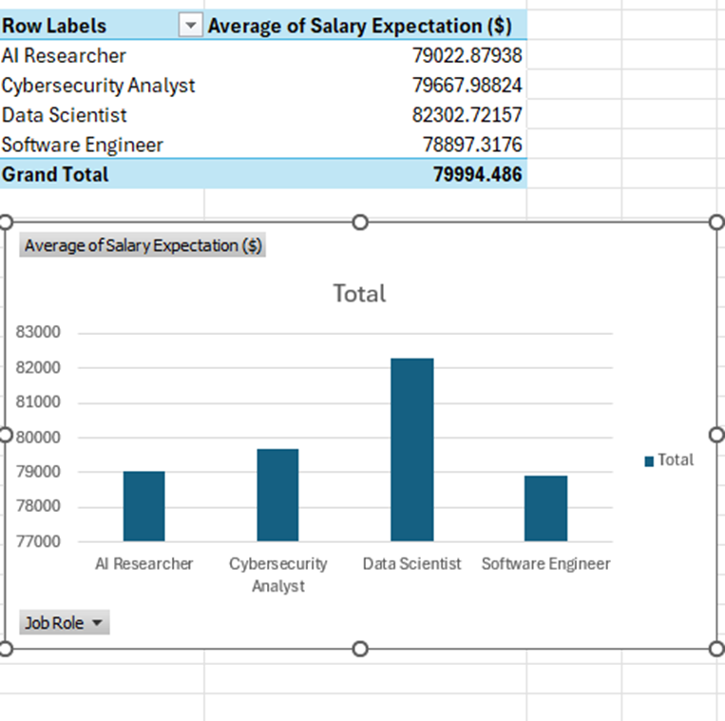
Salary Expectations across Job Roles
Based on the Pivot Table and Chart findings, Data Scientists had the highest salary expectations with an average of approximately $82,000

Slide 9
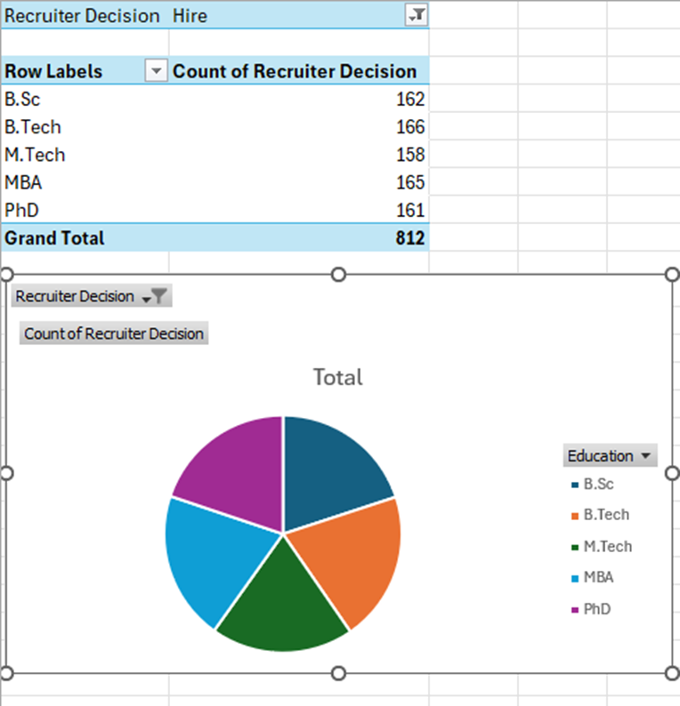
Distribution of Hired Candidates based on Education Level
Pivot Chart and Pivot Table insights showed that all education levels received fairly equal rates of hiring but candidates with a Bachelor’s or Master’s degree had a slightly higher hiring rate than others.

Slide 10
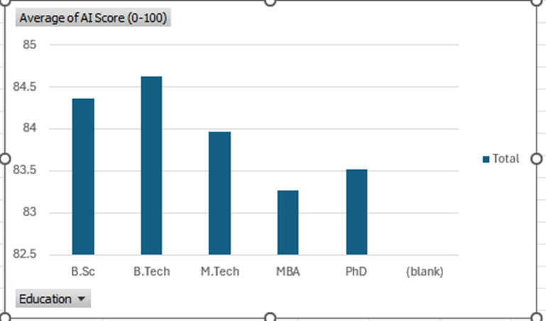
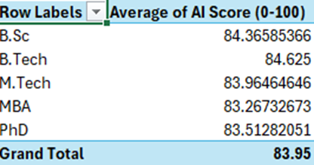
Average AI Score based on Education Level
Pivot Chart and Table analysis indicated that B.Sc and B.Tech holders had the highest average AI Scores.

Slide 11
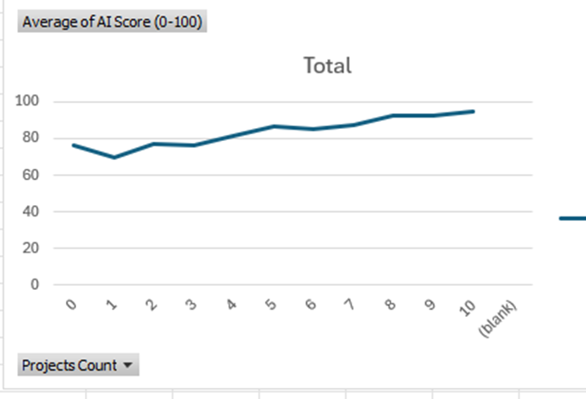
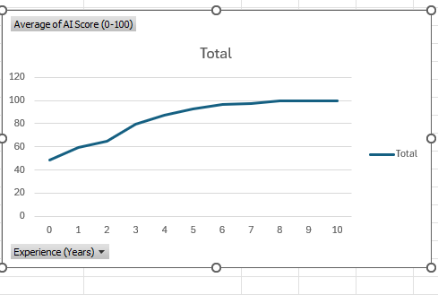
AI Score based on Project Count and Years of Experience
Insights showed that candidates with more than five projects also had 10% AI Score than those with fewer projects.
It was also determined that candidates with five or more years of experience consistently had AI Scores above 85.
Based safe these 2 visualizations, its safe to acknowledge that there is a strong correlation between the project count and the years of experience when it comes to AI score.

Slide 12
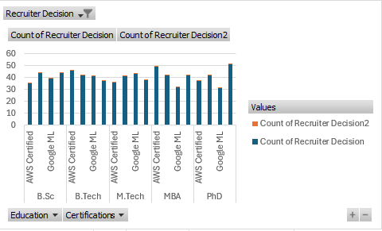
Education vs. Certificates
Based on findings, it is shown that Certifications can also play a role in the impact of the hiring decision.

Slide 13
Conclusion
Key Takeaways:
Experience and project count play a significant role in determining AI Scores.
Python, and SQL were the most common skills among hired candidates.
AI Researchers and Data Scientists had the highest salary expectations
Certifications positively impact hiring decisions, though education level alone is not a strong predictor.

